Slide 1
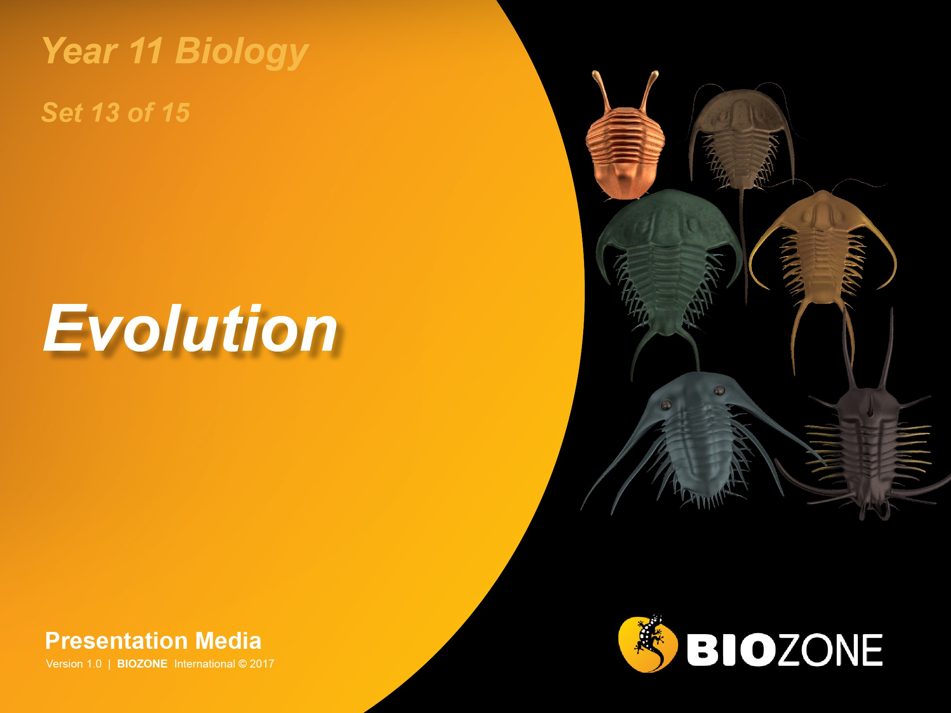

Slide 2
Speciation
Species
Speciation
Reproduction isolation
Allopatric speciation
Sympatric speciation
Patterns of evolution
Divergent evolution
Convergent evolution
Biogeography
Gradualism and punctuated equilibrium
Extinction

Slide 3
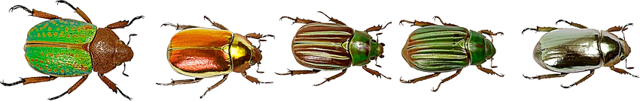
Species
A biological species is: a group of interbreeding (or potentially interbreeding) individuals, reproductively isolated from other such groups.
Species are often composed of different populations (often in different habitats) that are quite distinct.
These are often called subspecies, races, and varieties depending on the degree of reproductive isolation and the organism involved (e.g. varieties is a common term for plant breeds).

Slide 4
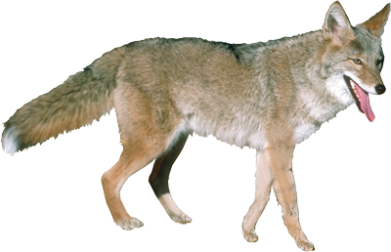
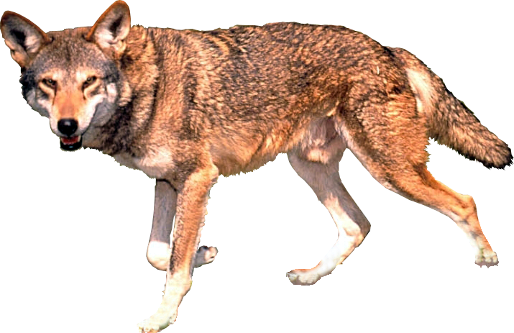
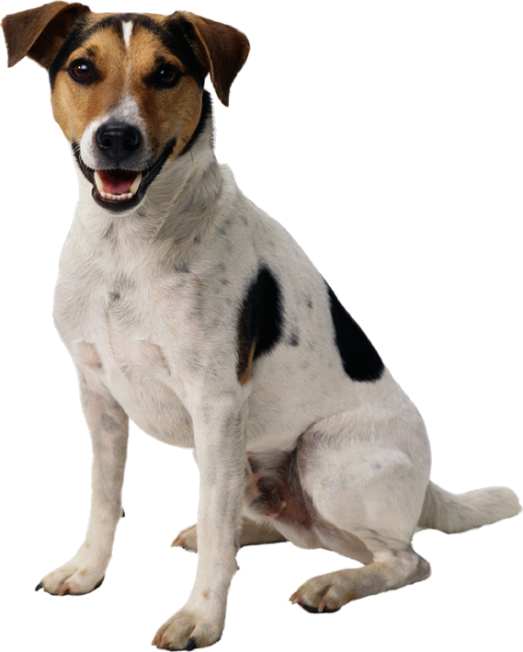
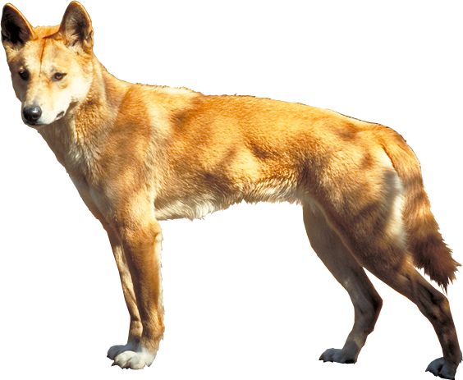
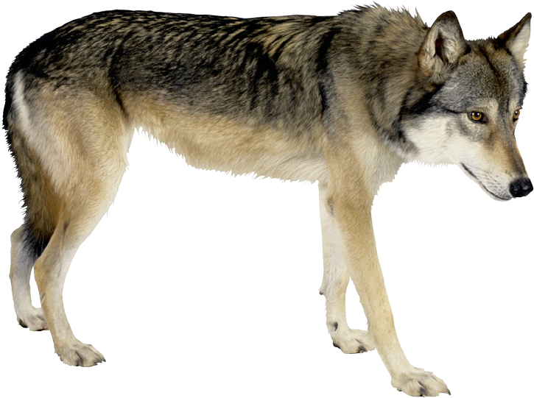
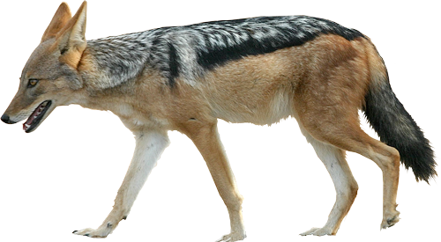
Species
The boundaries of a species gene pool can be sometimes unclear, such as the Canis genus to which all dogs, wolves, and related species belong:
Coyote–red wolf hybrids
Interbreeding
Interbreeding
Coyote
Canis latrans
Red wolf
Canis rufus
Inter-breeding
Inter-breeding
Domestic dog
Canis familiaris
Interbreeding
Inter-breeding
Interbreeding
Dingo
Canis familiaris dingo
Gray wolf
Canis lupus
No interbreeding
No interbreeding
Side-striped jackal
Canis adjustus
Black-backed jackal
Canis mesomelas
Golden jackal
Canis aureus

Slide 5
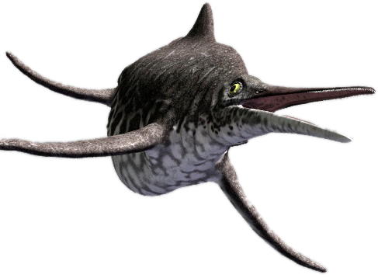
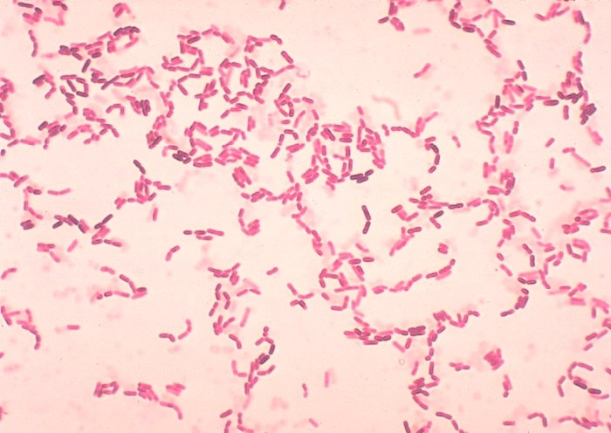
Limitations of the
Species Concept
The definition of a biological species does not apply in all situations:
The concept of a species being able to interbreed cannot apply to extinct populations because this is unknown. Extinct forms must usually be classified on morphology (appearance).
Asexually reproducing organisms (e.g. bacteria) do not breed with each other and so are assigned to species on the basis of appearance or biochemical similarities.
Ichthyosaurs were diverse in the Mesozoic but are now extinct
Bacillus bacteria, species that reproduce asexually
CDC

Slide 6
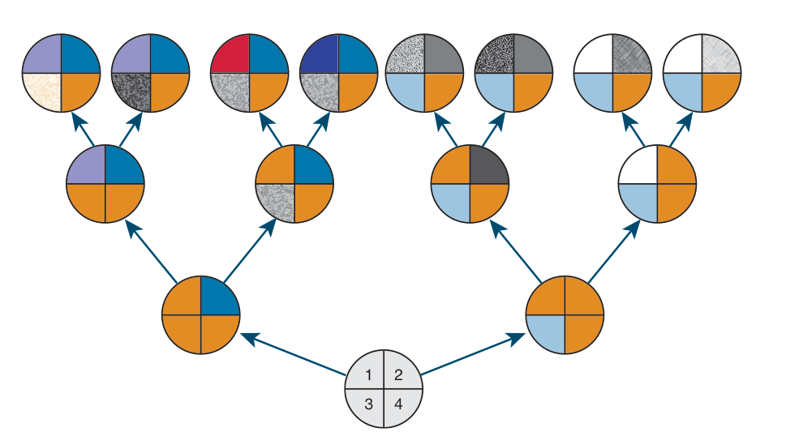
Phylogenetic Species
Phylogenetic species are defined on the basis of their shared evolutionary ancestry, which is determined by their shared derived characteristics.
These may be morphological or biochemical.
A species is the smallest group that shares a derived character state.
H
I
J
K
L
M
N
O
Individuals in a species share a unique derived character state
D
E
F
G
Living species H-K are related to a more recent common ancestor B because they share character 2
Living species L-O are related to a more recent common ancestor C because they share character 3
B
C
A

Slide 7
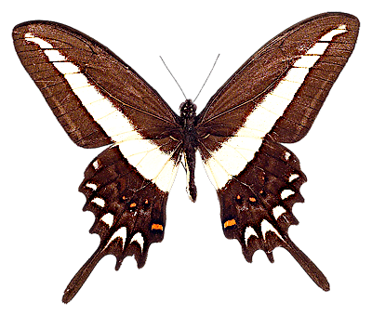
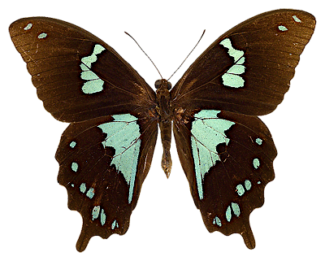
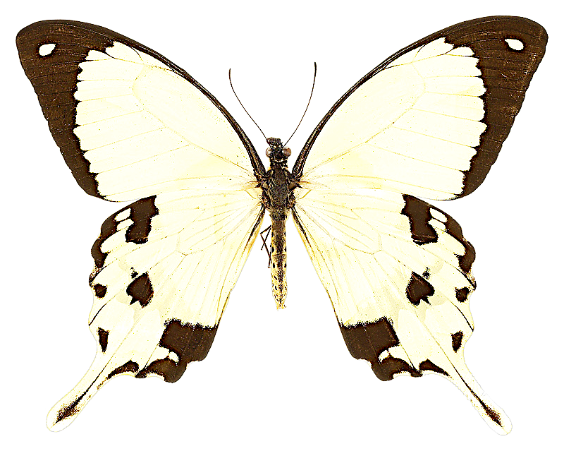
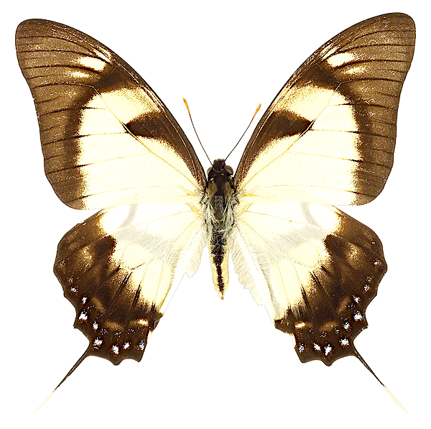
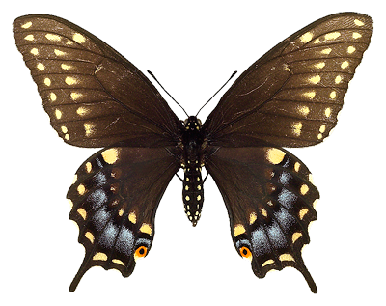
Speciation
Speciation refers to the process by which new species are formed.
Speciation occurs when gene flow has ceased between populations where it previously existed.
Speciation is brought about by the development of reproductive isolating mechanisms which maintain the integrity of the new gene pool.
Different species of swallowtail butterflies in the genus Papilio

Slide 8
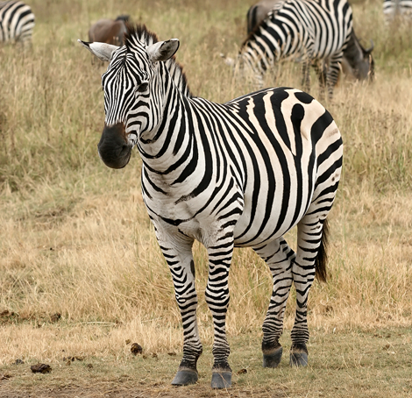
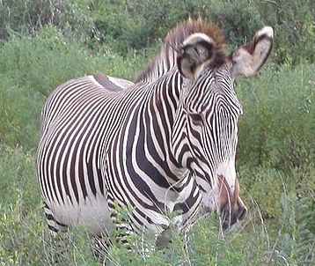
Reproductive Isolation
Good biological species are reproductively isolated from each other. They do not interbreed.
Reproductive isolating mechanisms (RIMs) prevent successful breeding between different species. They are barriers to gene flow.
A single barrier may not completely isolate a gene pool, but most species have more than one isolating mechanism operating to maintain a distinct gene pool.
Geographical barriers prevent species interbreeding but are not considered to be RIMs because they are not operating through the organisms themselves.
Equus quagga
Muhammad Mahdi Karim-GFDL 1.2
Equus grevyi
Jesse Hull-cc2.0
The plains zebra (E. quagga) and Grevy’s zebra (E. grevyi) may look similar to us, but they are reproductively isolated and separate species.

Slide 9
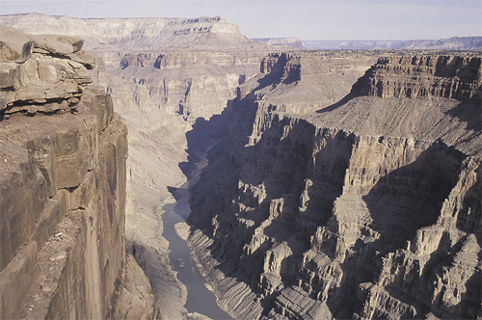
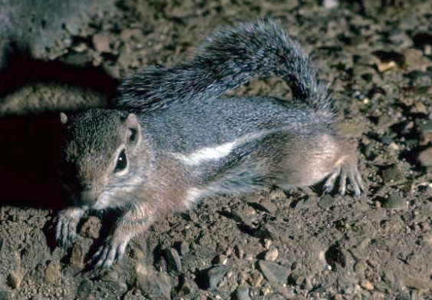
Geographical Barriers
Geographical barriers are physical barriers which isolate species and prevent interbreeding.
Geographical barriers include mountains, rivers, and oceans. Geographical features that may be barriers to some species may not be barriers to others.
In the USA, two species of antelope squirrels occupy different ranges either side of the Grand Canyon.
Their separation is both geographical and ecological. They are separated by the canyon and by the different habitat preferences in the regions they occupy.
AT
Although they are in the same region, the white tailed antelope squirrel inhabits desert to the north of the canyon, while Harris’s antelope squirrel (above) has a more limited range to the south.

Slide 10
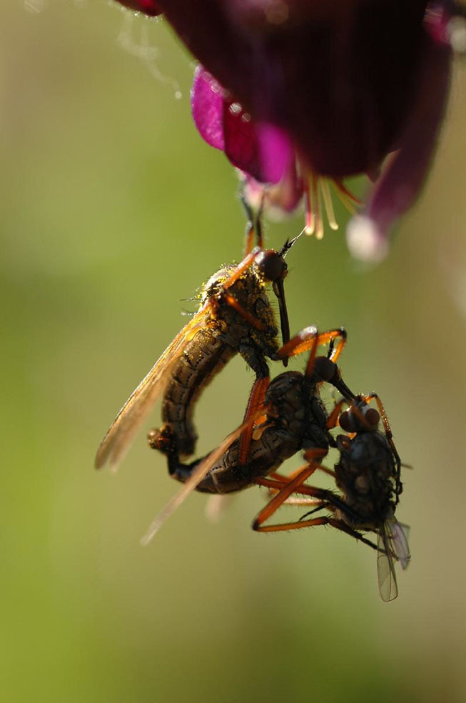
Reproductive Isolating
Mechanisms
Reproductive isolating mechanisms are categorised according to when and how they operate:
Prezygotic mechanisms operate before fertilisation occurs. They include:
habitat preference
behavioural incompatibility
structural incompatibility
physiological incompatibility
Postzygotic mechanisms operate after fertilisation has occurred. They include:
zygote mortality
poor hybrid fitness
hybrid sterility
Onno Zweers

Slide 11
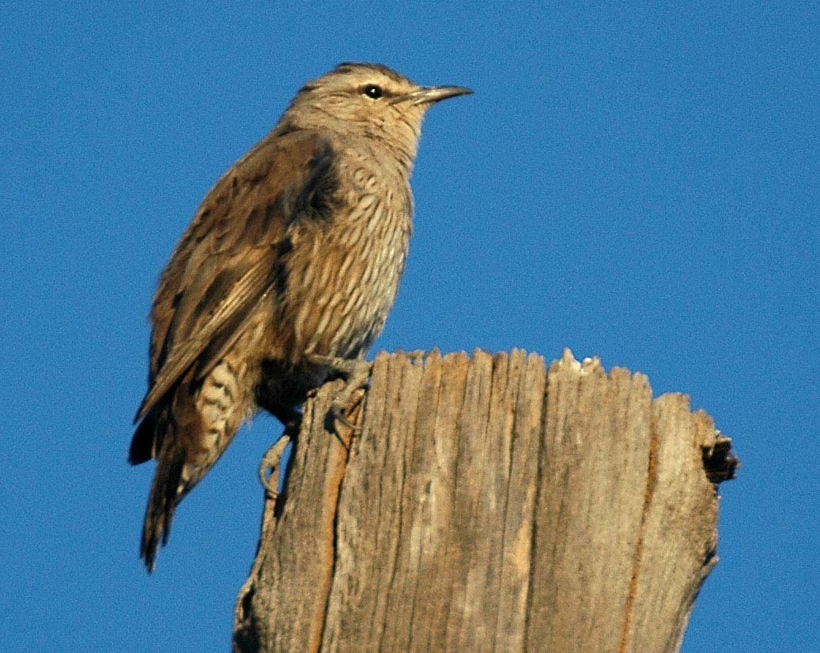
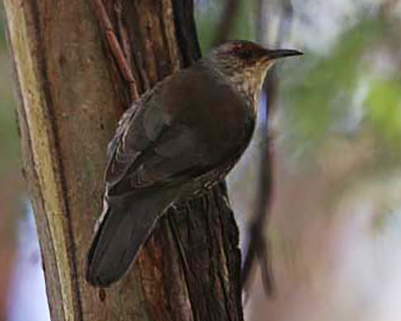
Prezygotic Isolating
Mechanisms
Prezygotic isolating mechanisms act before fertilisation to prevent successful reproduction.
Ecological or habitat:
Different species may occupy different habitats within the same geographical area, e.g. desert and coastal species, ground or tree dwelling.
In Australia, the red-browed and brown treecreepers (Climacteris spp.) occupy the same range in south-east Australia and both species feed largely on ants.However, the brown spends most of its time foraging on the ground or on fallen logs while the red-browed forages almost entirely in the trees.
Brown (top) and red-browed (bottom) treecreepers occupy different parts of the habitat.

Slide 12
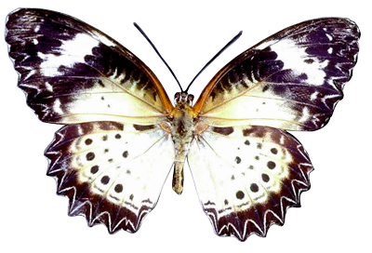
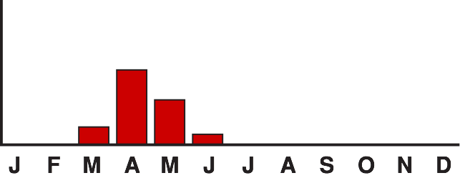
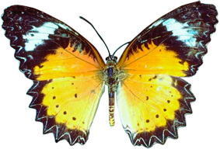
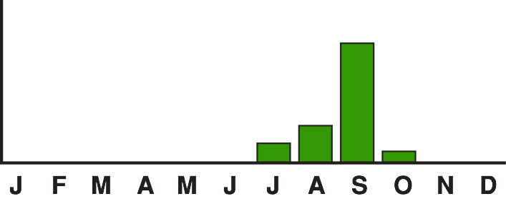
Prezygotic Isolating
Mechanisms 2
Temporal (time-based):
Species may have different activity patterns; they may be nocturnal or diurnal, or breed at different seasons.
In the hypothetical example on the right, the two species of butterfly will never mate because they breed at different times of the year.
Breeding season for species A
Breeding season for species B

Slide 13
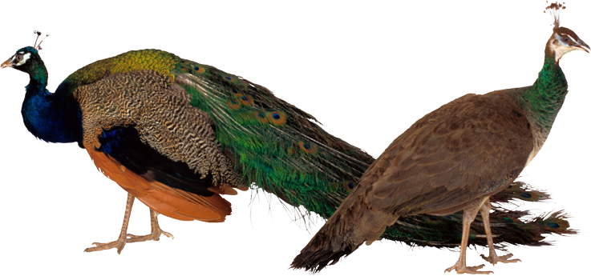
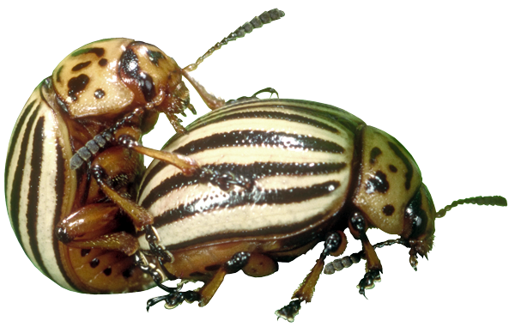
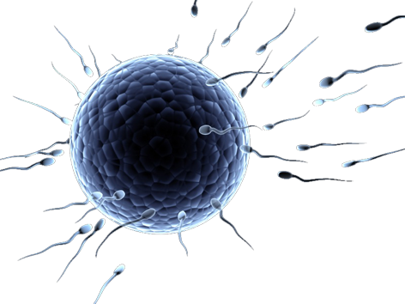
Prezygotic Isolating Mechanisms
Peacock
Behavioural:
Species may have specific calls, rituals, or postures that enable them to recognise potential mates. For example, many bird species have elaborate courtship behaviours and sexually dimorphic plumage (males are often showy and brightly coloured).
Structural:
For successful mating, species must have compatible copulatory apparatuses, appearance, and chemical make-up (odour, chemical attractants).
Gamete mortality:
If sperm and egg fail to unite, fertilisation will be unsuccessful.
Many insects have very specific copulatory organs, which act like a lock and key
Sperm
Egg
Attempted fertilisation

Slide 14
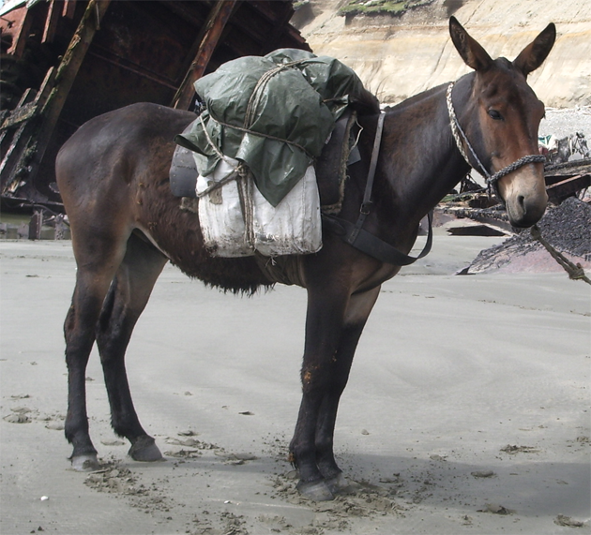
Postzygotic Isolating
Mechanisms
Species A
X
Species B
F1
Hybrid AB
X
Hybrid AB
Reduced viability
Reduced viability
Postzygotic isolating mechanisms act after fertilisation to prevent successful reproduction.
Hybrid inviability:
The fertilised egg may fail to develop properly.
Fewer young may be produced and they may have a low viability (survivability).
Hybrid sterility:
The hybrid of two species may be viable but sterile, unable to breed (e.g. the mule).
Hybrid breakdown:
The first generation may be fertile but subsequent generations are infertile or non-viable.
F2
Hybrid AB
Non-viable or sterile
This mule is a hybrid between a horse and a donkey. Mules are infertile.
PD

Slide 15
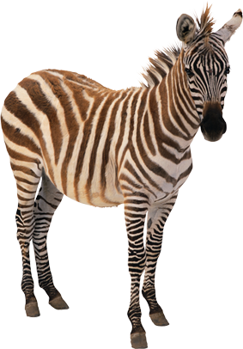
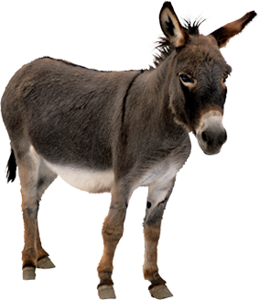
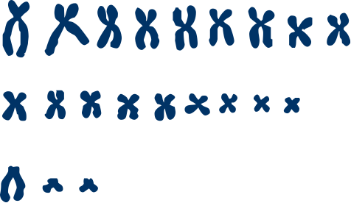
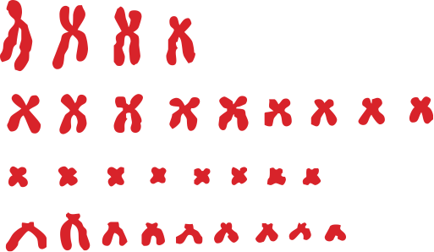
Hybrids in the Horse Family
Zebra stallion (2n = 44)
Donkey jenny
(2n = 62)
Sterile hybrids are common among the horse family.
The chromosomes of the zebra and donkey parents differ in number and structure, producing a sterile zebronkey.
X
‘Zebronkey’ offspring (2n = 53)
Chromosomes contributed by zebra male
Chromosomes contributed by donkey female
Y
X

Slide 16
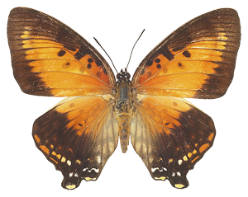
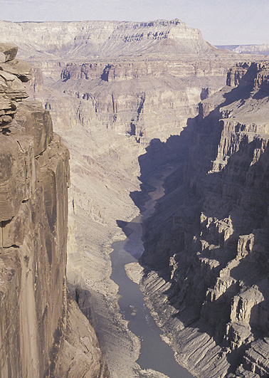
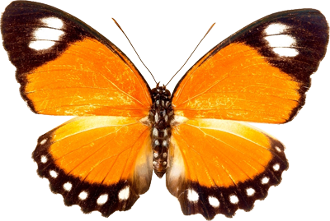
Types of Speciation
Several models have been proposed to account for new species among sexually reproducing organisms:
Allopatric speciation: Populations become geographically separated, and become subjected to different selection pressures. They establish reproductive isolating mechanisms in isolation.
Sympatric speciation: A population forms a new species within the same area as the parent species.
Parapatric speciation: The speciating populations do not overlap significantly but are adjacent, so there may be interactions between individuals along a narrow zone of contact.

Slide 17
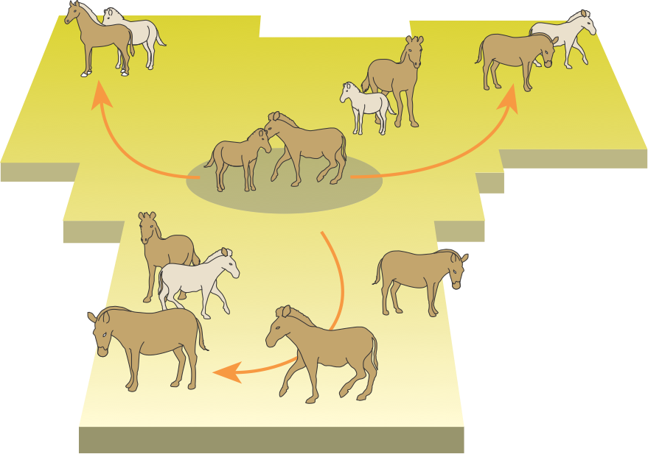
Allopatric Speciation 1
STAGE 1: Moving into new environments
The parent population expands its range and occupies new parts of the environment.
Expansion of the range may be due to competition.
The population has a common gene pool with regular gene flow (any individual has potential access to all members of the opposite sex for the purpose of mating).
Parent population

Slide 18
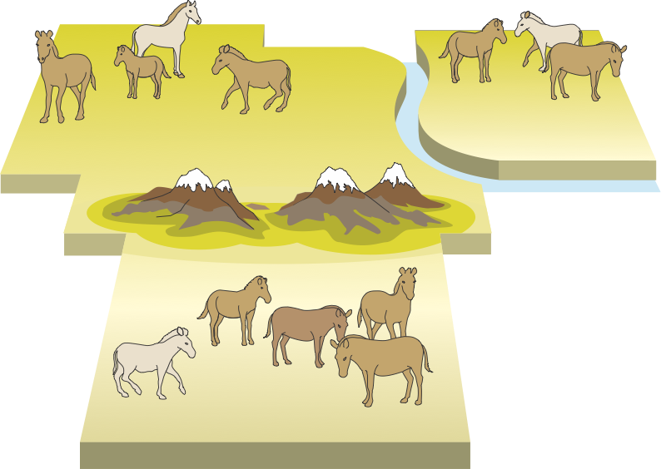
Allopatric Speciation 2
STAGE 2: Geographical isolation
Gradual formation of physical barriers may isolate parts of the population at the extremes of the species range.
As a consequence, gene flow between these isolated populations is prevented or becomes rare.
Agents causing geographical isolation include: continental drift, climatic change, and changes in sea level (due to glacials and interglacials).
River barrier prevents gene flow
Isolated Population A
Isolated Population B
Some natural variation exists in each population
Mountain barrier prevents gene flow
Isolated Population C

Slide 19
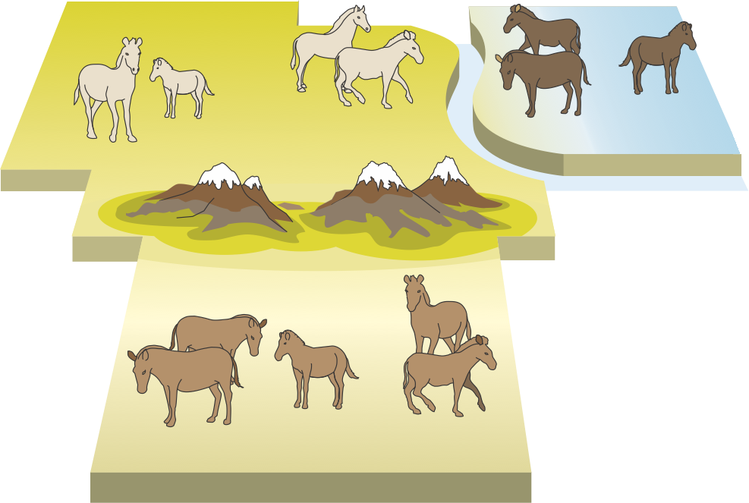
Allopatric Speciation 3
STAGE 3: Formation of a sub-species
The isolated populations may be subjected to quite different selection pressures.
These selection pressures will favour those individuals with traits suited to each environment.
Allele frequencies for certain genes change and the populations take on the status of a sub-species (reproductive isolation is not yet established).
Wetter climate
Cooler climate
Sub-species A
Sub-species B
Drier climate
Sub-species C

Slide 20
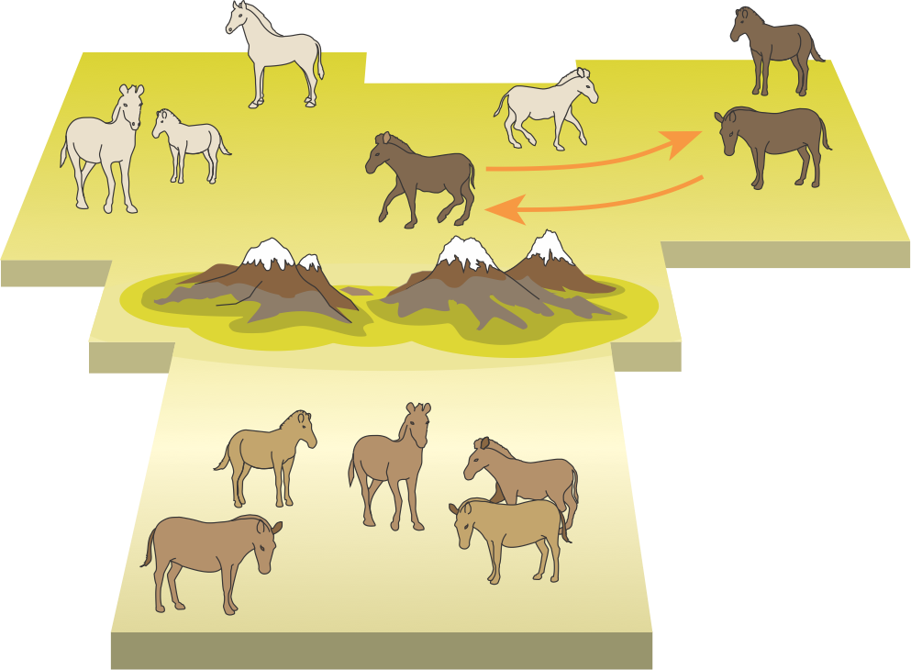
Allopatric Speciation 4
STAGE 4: Reproductive isolation
Each separated sub-species undergoes genetic and behavioural changes that prevent mating with individuals from other populations.
Each sub-species develops reproductive isolating mechanisms. The gene pools become isolated and the populations attain species status.
Even if geographical barriers are removed to allow mixing of the populations, genetic isolation is complete.
Sympatric species
Species A
Species B
River barrier removed
Mountain barrier remains
Allopatric species
Species C
Sympatric species: Closely related species with overlapping distribution
Allopatric species: Closely related species still geographically separated

Slide 21
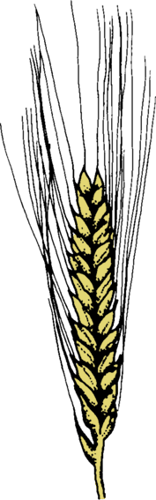
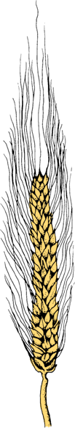
Sympatric Speciation
Sympatric speciation: A new species within the same area as the parent species.
There is no geographical separation between the speciating populations.
All individuals are, in theory, able to meet each other.
Sympatric speciation is relatively rare in animals, but it is an important mechanism for speciation among plants.
Sympatric speciation may occur through:
A change in host preference, food preference or habitat preference.
The partitioning of an essential but limiting resource.
Instant speciation as a result of polyploidy (particularly among plants, as in the evolution of wheat).
Wild Einkorn
Common Wheat

Slide 22
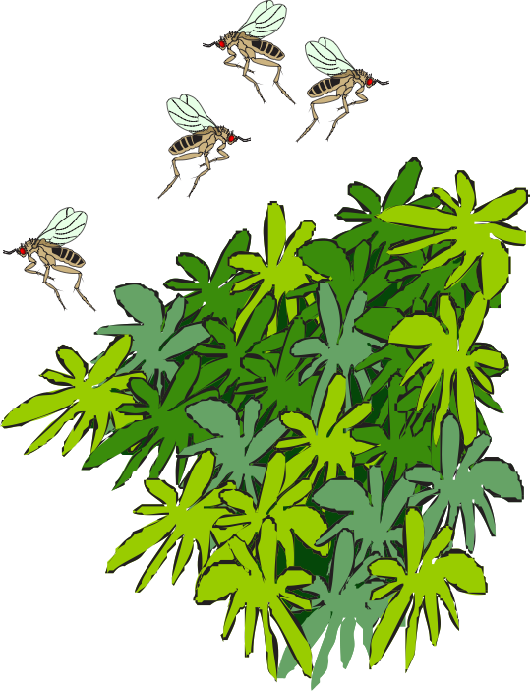
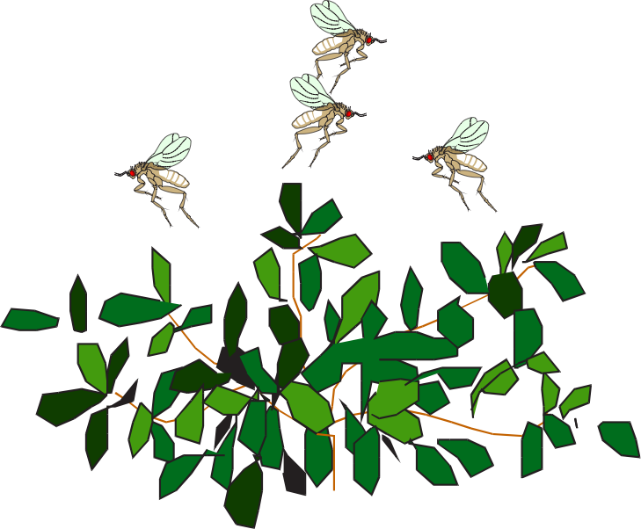
Sympatric Speciation 1
A change in habitat preference:
It is not uncommon for some insect species to be conditioned to lay eggs on the plant species on which they themselves were reared.
If the normally preferred plant species is unavailable, then the insect may be forced to choose another species to lay eggs on.
A few eggs surviving on this new plant will give rise to a new population with a new plant species preference.
Original host plant species
New host plant species
An insect forced to lays its eggs on an unfamiliar plant species may give rise to a new population of flies isolated from the original population

Slide 23
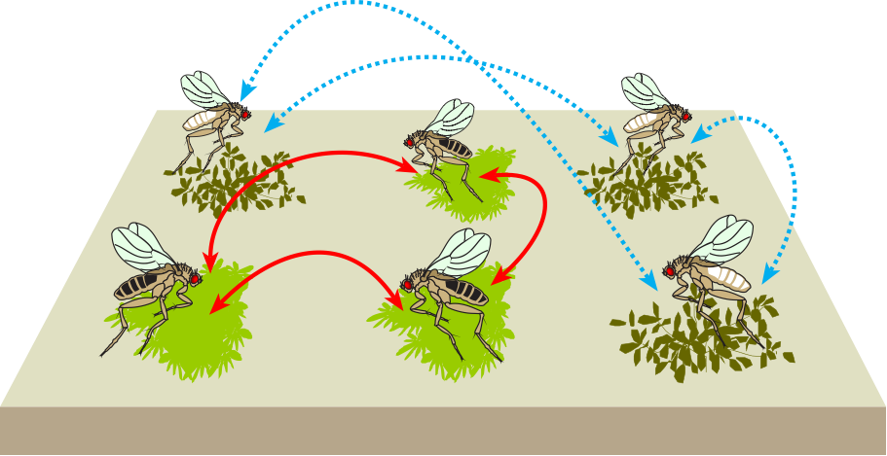
Sympatric Speciation 2
Establishing reproductive isolation:
If mating and rearing of offspring takes place entirely within the habitat, then the population will become reproductively isolated.
Further differentiation of the two populations is likely as each becomes increasingly adapted to their respective habitats.
Ultimately, the two groups will diverge to be recognised as separate species.
Gene flow
No gene flow
Original host plant species
New host plant species
Each host plant will attract flies that were reared on that plant species. Flies will mate with other flies with a similar preference.

Slide 24
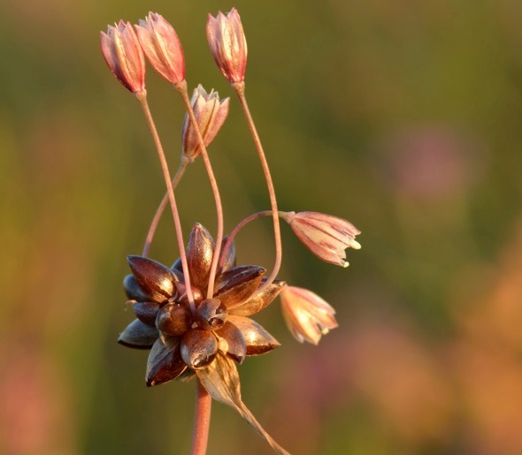
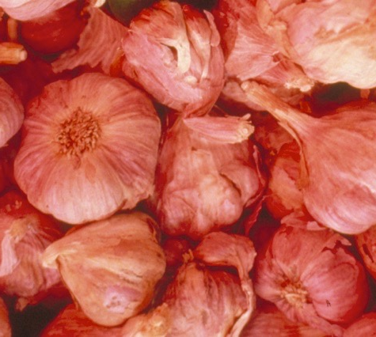
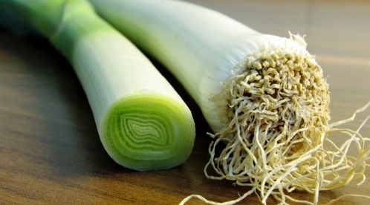
Polyploidy and Speciation
Polyploidy involves the multiplication of whole sets of chromosomes (each set being the haploid number N).
Polyploids occur frequently in plants and in some animal groups such as rotifers and earthworms.
When such individuals spontaneously arise, they are instantly reproductively isolated from their parent population.
As many as 80% of flowering plant species may have originated as polyploids.
A. oleraceum 5N = 40 chromosomes
Ivar Leidus CC 3.0
A. porrum 2N = 16 chromosomes
Different species of Allium (right) have arisen as a result of polyploidy. They have chromosome numbers (2n) that are multiples of 8: 2n = 16, 32, and 40.
A. sativum 4N = 32 chromosomes
Bjorn Konig CC 1.0

Slide 25






Speciation in
Australian Treecreepers
C. picumnus melanota
C. melanura melanura
Zone of sympatry due to secondary range expansion
Populations of treecreeper species are isolated by large regions of inhospitable habitat (desert and dry areas).
These geographical barriers (circles) are thought to have contributed to their speciation.
C. melanura wellsi
Secondary range expansion
Circles denote physical barriers to expansion of the species range
C. rufa
C. picumnus picumnus

Slide 26


Species Development
Taking a very simple view, speciation can happen in one of two ways:
Splitting: A species could split fairly equally into two populations that evolve differently until they eventually become separate species.
Budding: A small part of the species population could “bud off” from the main part and evolve rapidly (in terms of the geological time-scale) to form a new species while leaving most of the original species population unchanged.
Species B
B
C
Species C
Species A
A
B
Species B
Population splits equally
Small population buds off
A
Species A
Species A
A
Splitting
Budding

Slide 27





Divergent Evolution
The diversification of an ancestral group into two or more species in different habitats is called divergent evolution.
Divergent evolution involving the formation of a large number of species to occupy different niches is called adaptive radiation.
Right: a hypothetical family tree showing divergence from common ancestors on two occasions.
Changes in the genetic make-up of the two species
Speciation by splitting
Genetic changes accumulate to form a new species
Extinction
Speciation by budding
Little genetic change: species remains relatively unchanged
Time

Slide 28

Adaptive Radiation
The radiation of the mammals occurred after the extinction of the dinosaurs, which made niches available for exploitation.
The mammals have diversified widely to fill many different niches.
Marine predator niche
Arboreal herbivore niche
Underground herbivore niche
Terrestrial predator niche
Freshwater predator niche
Browsing/ grazing niche
Flying predator/ frugivore niche
Megazostrodon
an early mammal ancestor

Slide 29







Divergent Evolution of the Ratites
The ratites are an ancient group of birds that have evolved from one ancestor and lost their powers of flight early in their evolutionary development.
Their distribution can be explained by continental drift following the break-up of Gondwana.
Ostrich
Africa
Emu
Australia
Kiwi
New Zealand
Moa
New Zealand (extinct)
Elephantbird
Madagascar (extinct)
Rhea
South America
Cassowary
Australia/New Guinea

Slide 30

Divergence of Ratites
New genetic studies of mitochondrial DNA (mtDNA) suggests kiwis are most related to the extinct elephant bird from Madagascar and slightly less closely related to emus in Australia.
However, the ancestor to the kiwi arrived in New Zealand long after New Zealand separated from the rest of Gondwana.
Ancestral kiwi must therefore have flown there. Moas are now thought to be closely related to tinamous (South America), which can fly.
Ostriches were thought to be closely related to elephant birds but mtDNA now suggests they diverged from the other ratites early.
The conclusions from these new findings suggest that the ratites evolved from flying birds that flew between continents and independently evolved flightlessness at least six times.
Moas diverged from tinamous about 55 million years ago
Moa
Tinamou
Ratites diverged from other birds between 90 and 70 million years
Elephant bird
Kiwi
Emu
Birds evolved from theropod dinosaurs
Cassowary
Rhea
Ostrich
Other birds

Slide 31


Mammal Adaptive Radiation
Mammalian taxa
Sea-cows
Elephants
Hyraxes
Even-toed ungulates
Aardvark
Odd-toed ungulates
Whales & dolphins
Carnivores
Pinnipeds
Early mammals
Placentals diverge from marsupials
Insectivores
Bats
Colugos
Primates
Elephant shrews
Rodents
Hares, rabbits
Pangolins
Anteaters, sloths
Marsupials
Monotremes

Slide 32

















Mammal Adaptive Radiation
Modern mammals are represented by 17 orders:
Chiroptera
Insectivora
Xenarthra
Probiscidea
Carnivora
Perissodactyla
Pholidonta
Lagomorpha
Cetacea
Artiodactyla
Tubulidentata
Sirenia
Primates
Rodentia
Pinnipedia
Dermoptera
Hyracoidea

Slide 33




Convergent Evolution
Not all morphological similarity is inherited from a common ancestor:
Species from different evolutionary branches may resemble each other if they have similar ecological roles.
This is called convergent evolution.
Similarity due to convergence is not a basis for including species in the same taxon.
Example: The swimming carnivore niche.
This niche was exploited by a number of unrelated vertebrate groups at different times in the history of life.
The selection pressures of this niche produced fins or flippers and a streamlined body shape for rapid movement through the water.
Reptile: icthyosaur (extinct)
Fish: shark
Mammal: dolphin
Bird: penguin

Slide 34




Convergence and Analogous Structures
Not all similarities between species are inherited from a common ancestor.
Structures that have the same function in different organisms may come from quite different origins. This phenomenon is termed analogy.
Analogous structures do not imply an evolutionary relationship, but may indicate convergence. Examples:
Eye structure in octopus and mammals.
Wings in birds and butterflies.
Fins in fish and flippers in mammals
Fins
Flippers
Wings

Slide 35





Analogy in Eye Structure
Eyes in cephalopods (such as octopus) and mammals have the same function and are structurally similar, but have evolved from different origins.
Mammalian eye
Iris
Lens
Cornea
Photo: Jo Naylor cc 2.0
Retina
Octopus eye
Retina
Iris
Lens
Cornea

Slide 36












Convergent Evolution in Mammals
Marsupial and placental mammals have evolved separately to occupy equivalent niches on different continents. They are ecological equivalents.
Marsupial mammals
Australia
Placental mammals
North America
Wombat
Wood chuck
Flying phalanger
Flying squirrel
Marsupial mole
Mole
Marsupial mouse
Mouse
Tasmanian wolf
Wolf
Long-eared
bandicoot
Rabbit

Slide 37




The Biogeography of the
Camel Family
The camel family comprises six modern-day species that have survived on three continents:
Arabian camel
Bactrian camel
Llama
Vicuña
Alpaca
Guanaco
There are no surviving species on their continent of origin, North America, where they emerged about 40 million years ago and later dispersed to other continents.
Arabian camel (dromedary)
Bactrian camel
Llama
Guanaco

Slide 38


The Biogeography
of the Camel Family
Recent distribution
Tertiary distribution
Camel ancestor in North America 40 mya
Llama
Lama glama
Arabian camel
Camelus dromedarius
Four llama species: llama, alpaca, guanaco and vicuña
Land bridge across the Bering Strait 1 million years ago
Bactrian camel
Camelus bactrianus
Vicuña
Vicugna vicugna
Guanaco
Lama guanicoe

Slide 39






Phyletic Gradualism
New species
Parent species
Phyletic gradualism assumes that populations slowly diverge from one another by accumulating adaptive characteristics in response to changing selection pressures.
If species evolve by phyletic gradualism there should be transitional forms seen in the fossil record (as with the evolution of the horse and whale).
Each species undergoes gradual changes in its genetic makeup and phenotype
A typical pattern
New species diverges from the parent species

Slide 40



Punctuated Equilibrium
Punctuated equilibrium proposes that most of a species existence is spent in stasis and little time is spent in active evolutionary change.
There is abundant evidence in the fossil record that, instead of gradual change, species stay much the same for long periods (stasis) and then have short bursts of evolution that produce new species quite rapidly.
New species
Parent species
New species
A typical pattern
New species 'bud off' from the parent species and undergo rapid change, followed by a long period of stability

Slide 41


Extinction
Extinction refers to the death of an entire species. No individuals are left alive.
Most species that have ever lived are now extinct.
Entire lineages that were once dominant have now disappeared or have dwindled in numbers as other radiations have flourished.
Often, the extinction of one group has allowed another to undergo extensive radiation into free niches. Large scale species changes are probably opportunistic events.
Radiations may follow extinctions but are rarely the cause of them.
Giant wombat Phascolonus gigas
Short-faced giant kangaroo Procoptodon goliah
The extinction of megafauna, such as Australia’s giant kangaroo and giant wombat, was a global phenomenon. Africa is now the only continent still with a significant mammalian megafauna.

Slide 42





Mass Extinctions
The Permian extinction (252 mya) marks the Paleozoic-Mesozoic boundary
Over 90% of marine species perished and probably many terrestrial ones also.
The Cretaceous extinction (65 mya) marks the Mesozoic-Cenozoic boundary
Exterminated more than half the marine species and many families of terrestrial plants and animals, including dinosaurs (but not their descendants, the birds) .
Palaeozoic
Mesozoic
Cenozoic
Cretaceous
Ordovician
Triassic
Devonian
Permian

Slide 43


Causes of Mass Extinctions
Mass extinctions are the result of more widespread and possibly catastrophic events than those that affect individual species.
Theories for mass extinctions include:
Changes in climate due to continental drift (slow). Sea level changes caused by successive ice ages and interglacials are implicated in most cases.
Dust from volcanic activity on a huge scale causing a cooling of the planet (faster).
Asteroid/comet impact causing a dust cloud and cooling effect (immediate).
NASA
Erupting volcano from satellite
NASA
NASA
Asteroid impact (artist’s impression)

Slide 44


Causes of Mass Extinctions
Yucatan Peninsula
Mexico City
The Permian extinctions occurred at about the time the continents merged to form the super-continent of Pangaea. This would have caused a major disturbance or destruction of many habitats and altered the climate.
There is good evidence for an asteroid or comet strike at this time, which may have created a cloud of dust, blocking light and inducing a “nuclear winter”.
A probable site for the impact crater lies just off the coast of the Yucatan Peninsula in Mexico.
In 2006, an even bigger asteroid impact crater was found under the Wilkes Land ice sheet of Antarctica. It may also have been responsible for a mass extinction.
NASA
The Chicxulub crater left by an asteroid impact off the Yucatan Peninsula, Mexico

Slide 45


Slide 46
Conditions of Use
NOTE: Presentation Media = presentations available on CD-ROM/DVD-ROM or as downloads
BIOZONE retains copyright to the intellectual property included in the Presentation Media files, with acknowledgement that certain photos are used under license and are credited appropriately.
You MAY:
Use the Presentation Media files for presentations in your classrooms using a data projector, interactive whiteboard or overhead projector.
Place the Presentation Media files on any staff computer within the school, including staff laptops, but not in contradiction to clause (g).
Place the Presentation Media files on:
The school’s intranet (school computer network)
VLE (Virtual Learning Environment)
A CMS (Content Management System).
Student and staff access must be restricted to those who are enrolled/working on the campus of the registered purchaser. Student and staff access to a VLE or a CMS must be controlled by a user login and password protocol, but not in contradiction to clause (f). If students have access, they need to be made aware of the Conditions of Use and are only allowed to view the content.
Edit and customise the Presentation Media files by adding, deleting, and modifying information to better suit your needs, but not in contradiction to clauses 2 (c) - (d).
Print out the Presentation Media files in PowerPoint® or Keynote® “Handouts” mode for the express purpose of allowing students to make their own notes about the presentation, but not in contradiction to clause (e).
You MAY NOT:
Place the Presentation Media files on to the Internet or on a service that may be accessed off-campus unless access to the service is protected by a user login and password protocol, and is restricted to students and staff enrolled/working on the campus of the registered purchaser.
Place the Presentation Media files on student laptop computers.
REMOVE any of the references to BIOZONE, the title slides, copyright notices, photo credits, or Conditions of Use from the Presentation Media files.
Create a NEW document using any of the graphics/images in the Presentation Media files.
Print the Presentation Media files on to paper to make your own worksheets for distribution to students.
Incorporate any part of the Presentation Media files for the production of another commercial product.
Share or give away any content off-campus. This prohibition apples to, but is not limited to, sharing via the Internet or any website, (examples: YouTube, slide sharing websites).
Conditions of Use are subject to change without notice. Visit http://www.biozone.com.au/faqconditionsofuse/

Slide 47
Photo Credits
Photographic images are used under license from the following commercial photo libraries:
Corel Corporation Professional Photos (uncoded)
ArtToday.com (coded AT)
Clipart.com (coded CA)
PhotoObjects.com (coded PO)
iStock.com (coded iStock)
Hemera Technologies Inc. (coded Hemera)
Photos.com (coded PC)
Education interactive (coded EII)
Digital Stock (coded DS)
LifeArt (coded LA)
Dollar Photo Club (coded DPC)
3D models were created using Poser
Additional artwork and photographs are the property of BIOZONE International Ltd. All rights reserved.
Some 2D artwork has been adapted from TechPool STUDIOS LifeArt Collections, used under licence.
Images from the Public Domain: Where these licenses have been used, authors and licenses have been acknowledged alongside their image.
Centers for Disease Control (coded CDC)
National Institutes of Health (coded NIH)
National Aeronautics and Space Administration (NASA)
Images from the public domain include limited copyright, copyright expired, uncopyrighted, or uncopyrightable material:
Licenses including: GNU Free Documentation License http://www.gnu.org/copyleft/fdl.html
Creative Commons Attribution Share Alike http://creativecommons.org/licenses/by-sa/3.0/
Wikimedia Commons
NOTE: Where images are edited or moved from or within this file, the accompanying photo credit must be retained.

Slide 48


